Slide 1
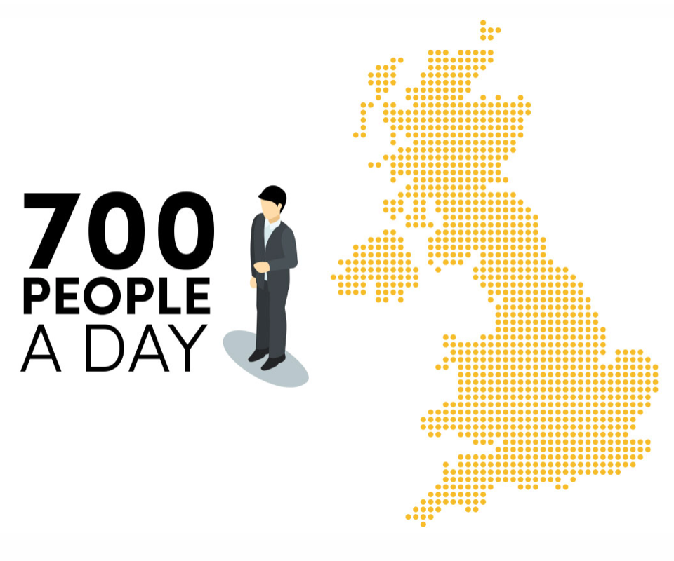
We support organisations to increase understanding and awareness around diabetes at work.
Increasing understanding about the risks on health and safety could save lives, increase productivity, decrease absenteeism and support people in sharing.

Slide 2
Partnered with Being Well Together

Slide 3
Being Well Together
A programme developed by experts operating across all 5 domains of wellbeing, which provides organisations with a framework through which they are guided on how to implement informed, impactful, and sustainable wellbeing strategies.
The Being Well Together programme offers organisations the tools to ensure positive wellbeing related conversations are taking place and empowering staff to make positive wellbeing related choices.

