Slide 1
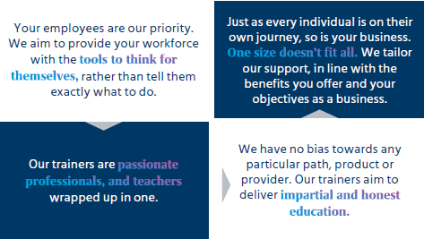
Not Peer Reviewed
MMB Workplace Education
“We promise to deliver unbiased and flexible education programmes, training your people to think for themselves with a focus on improving their overall wellbeing”
Contact
To find out more about the Education and Financial Wellbeing services we provide you can either contact your existing Mercer or Marsh Consultant, or contact the Workplace Education Team directly at: Workplace-Education@MercerMarshBenefits.com

Slide 2
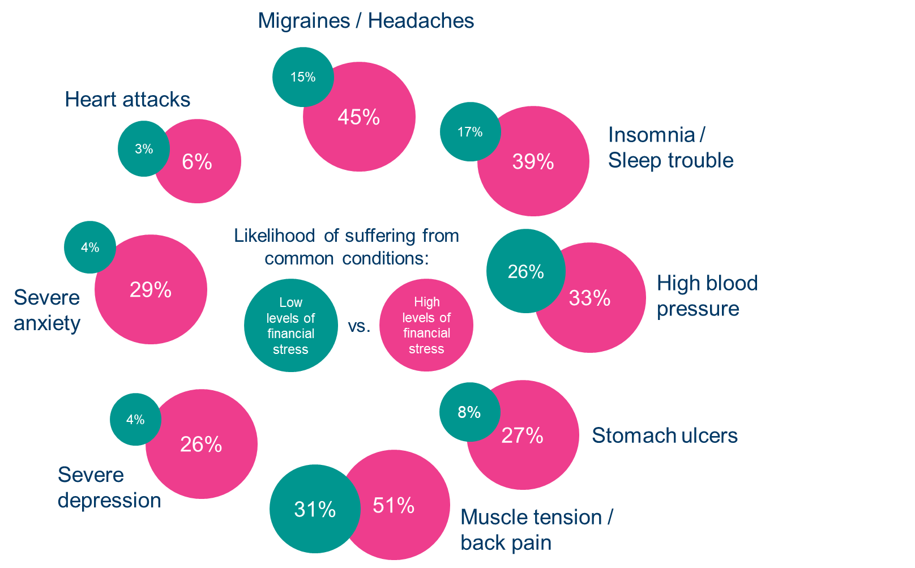
Financial Wellbeing and Health
High levels of financial stress dramatically increase vulnerability to physical and mental health problems
Source: AP-AOL Health poll: Debt stress: The toll owing money takes on the body

Slide 3
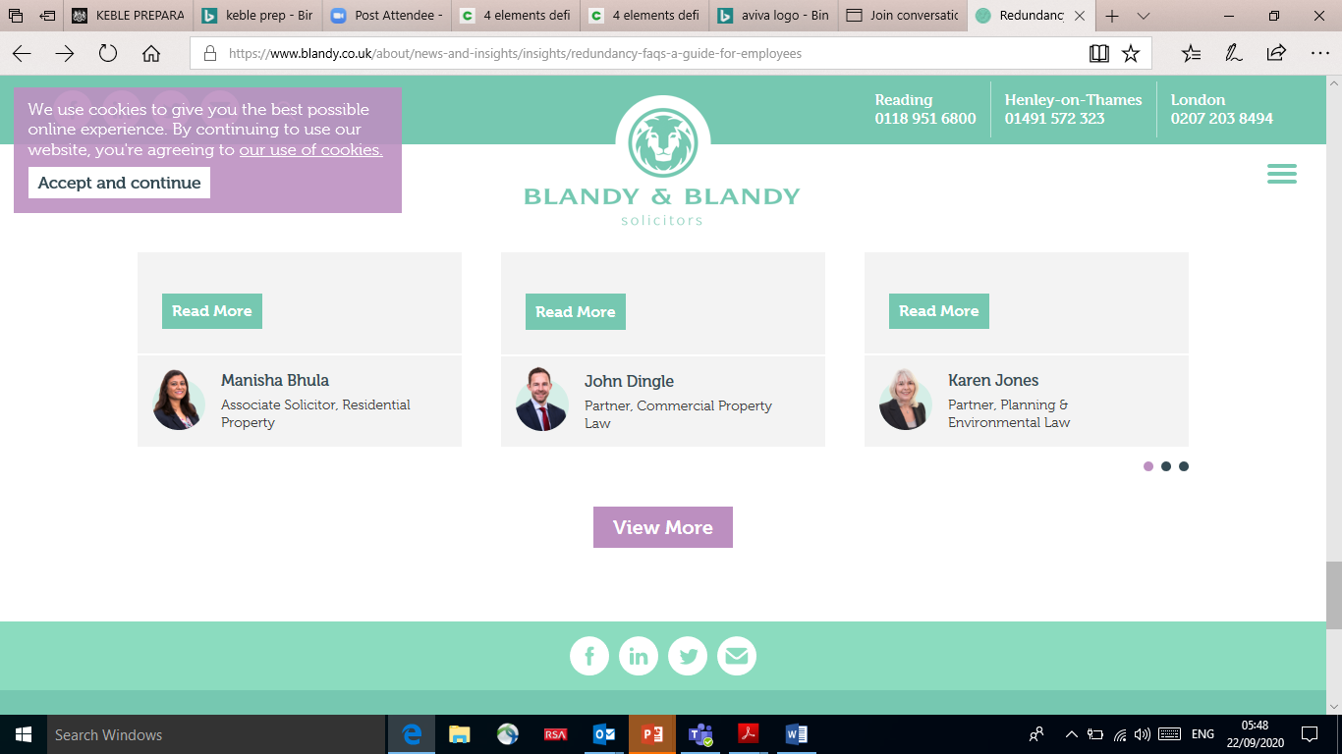
But what’s happening in the workplace?
[
94% of UK workers are affected by money worries
52% have borrowed to meet basic needs
c.8.3 million people in the UK unable to pay off debts or household bills
£197,384 average first time buyer house price in December 2019
22% of UK workers have savings less than £100
£36,000 average student debt 2019
Pre-Covid
46% of people in problem debt also have a mental health problem
20.77% average credit card interest rate in January 2020
£15,385 average UK household debt exc mortgages
590,000 falling into rent arrears.
49%could last three months or more without borrowing if main source of income is lost
23% finances impacted,
63% stressed or anxious.
Since Covid
Sources - Neyber – Financial Wellbeing survey of 11,000 employees & 720 organisations, 2019. Close Brothers Financial Wellbeing Index 2019.
National Audit Office Tackling Problem Debt report 2019. The Money Charity Statistics February 2020. Building Societies Association – May 2019.
Money & Mental Health Policy Institute 2019. TUC analysis, January 2019. Stepchange June 2020. Fincap May 2021. ONS 2020.

Slide 4
Overcoming human behavioural barriers
Focus on the short-term
We want to make ourselves happy today and can see ourselves behaving better in the future.
Habit
We are habitual by nature. We don’t challenge ourselves unless something jolts us into action.
Inertia
We fail to act, sometimes because there is too much choice and information out there.
Not taking a holistic view
It’s easier to deal with one decision at a time.

Slide 5




Defining Financial Wellbeing – Mercer Framework
Addressing all needs – the 4 Elements
Present
Future
Freedom
Control over the day-to-day
Not overspending income. Debt and expenses are manageable.
Freedom to make choices in life
Including access to resources or financial guidance to improve their situation.
Security
Prepared for the unexpected
Having the capacity to absorb a financial shock.
On track for the future
Having a plan for the future and saving towards it.

Slide 6
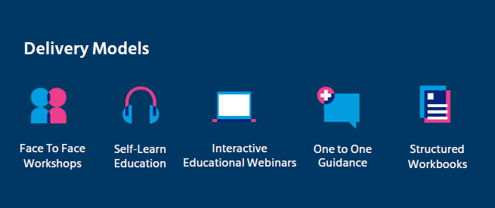
Supporting Financial Wellbeing

Slide 7
When employees thrive,
so do their employers

