Slide 1
To create a wellbeing culture where our people are happy, healthy and safe enabling everyone to thrive and achieve their full potential.
Notes:
Annual programme of events set in advance
Third party support
Monthly wellbeing champion calls
Recognisable brand

Slide 2
Our Global calendar and Intranet site

Slide 3
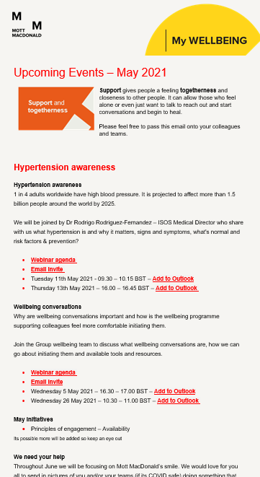
Upcoming May events
Hypertension Awareness & Wellbeing conversations
Webinars
11 & 13 May – Hypertension awareness
05 & 26 May – Wellbeing conversations
Other events
Principles of engagement – Availability
Culture and Diversity – Wellbeing
31 days of wellbeing – Challenge – Available to join now
To create a wellbeing culture where our people are happy, healthy and safe enabling everyone to thrive and achieve their full potential.

Slide 4
Sharing learning

Slide 5
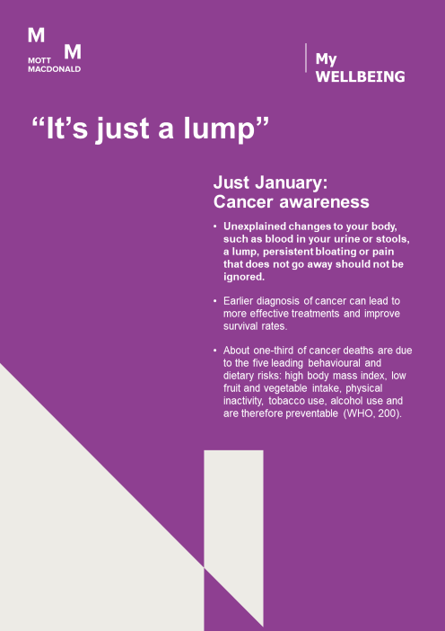
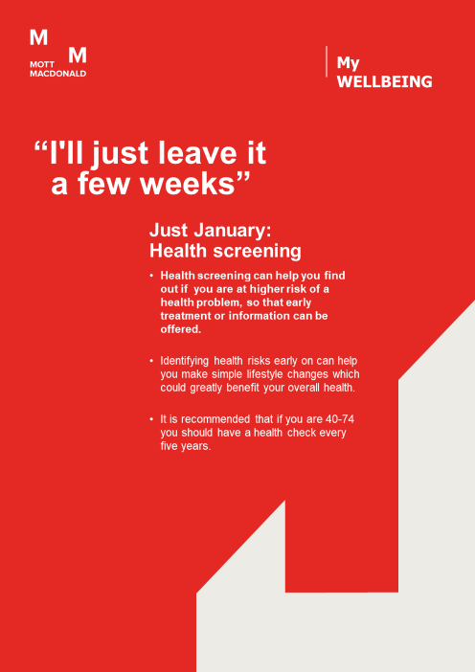
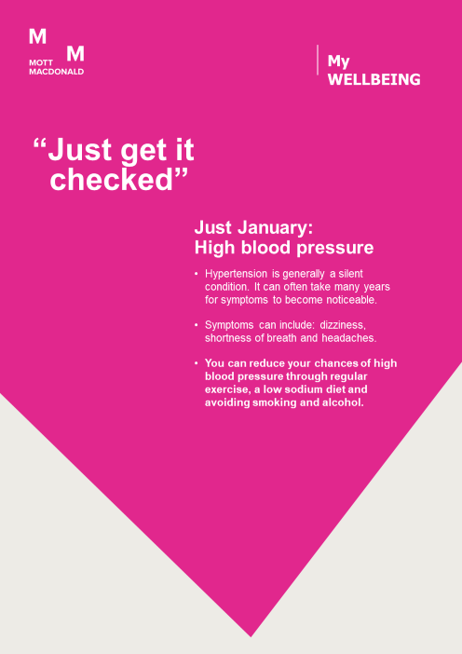

Slide 7
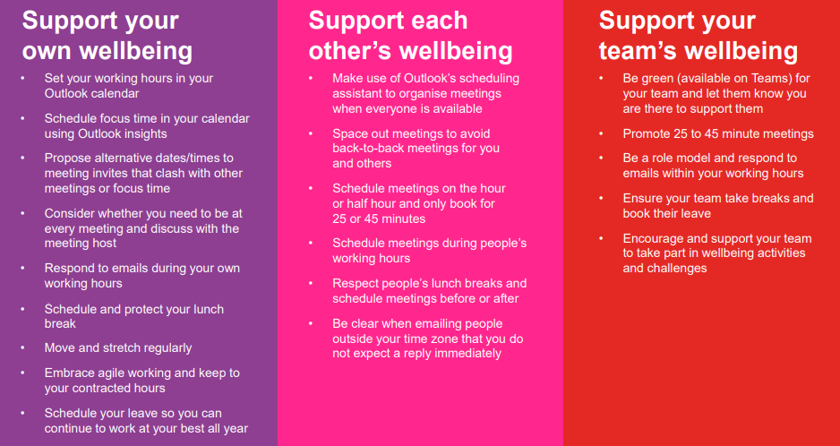

Slide 8
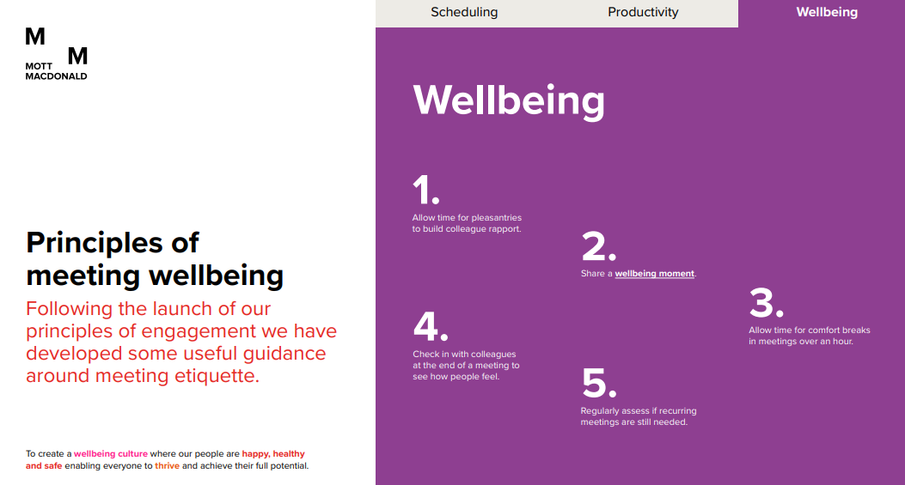
To create a wellbeing culture where our people are happy, healthy and safe enabling everyone to thrive and achieve their full potential.

Slide 10
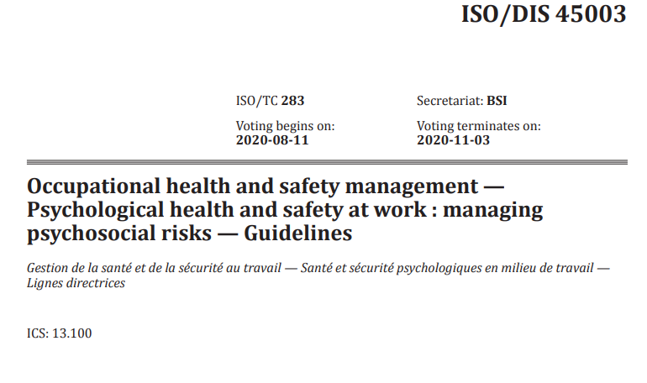
ISO/DIS 45003
Psychological health and safety at work
How aligned is our wellbeing programme?
To create a wellbeing culture where our people are happy, healthy and safe enabling everyone to thrive and achieve their full potential.

