Slide 1
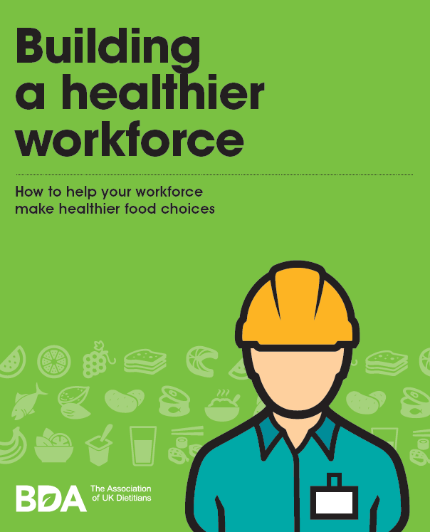
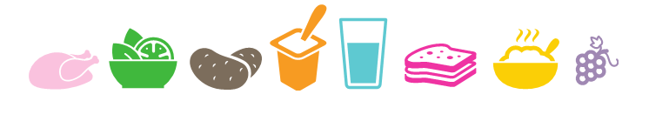
Jo Lewis – BDA Work Ready

Slide 2
Factors that influence wellbeing in the workplace
A poor working environment:
  Long hours and no breaks
  High-pressure environment with unrealistic expectations
Lifestyle behaviours:
  Physical activity and sedentary behaviour
  Mindfulness & relaxation techniques
  Sunlight (vitamin D)
  Nutrition
Nutrition programmes should always be part of a holistic approach
Notes:
Where does nutrition fit in to the broader picture? Many companies tell us that ’wellbeing’ is too broad and they’re unsure where to start.

Slide 3
Where does nutrition fit in for construction workers?
Consuming the right food and drink to aid focus and concentration and maintain safety
Dealing with limited facilities to prepare food
Coping with poor access to healthier choices in remote sites
Meeting high energy needs with healthy food, snacks and hydration
Coping with long shifts and early starts
Travelling long distances for work
Adequate nutrition whilst living away from home
Notes:
Studies showing moderate dehydration equivalent to drink driving; nurses missing meal breaks having awful accidents on the way home from a shift

Slide 4
Key eating patterns associated with mood and wellbeing:
Eat regular meals
Include a range of nutrient dense foods in your diet
Keep well hydrated
Notes:
Making breakfast a priority and protecting lunch breaks
A major barrier to food accessibility and positive eating behaviours is poor access to adequate meal breaks
A recent poll by the BDA found that 62% of employees always or sometimes skip their lunch break
2. All the food groups contain important nutrients that fuel our brains and bodies at work
3. Fluid losses from:
Air con
Hot environment
Protective clothes
Barriers to access
Limited access
Not taking breaks
Long hours
References & Resources
The Eat Well Guide
https://www.gov.uk/government/publications/the-eatwell-guide
BDA Food Fact Sheet
https://www.bda.uk.com/foodfacts/HealthyEating.pdf
https://www.bda.uk.com/foodfacts/food_fact_sheet_information_sources/healthyeatinginfo

Slide 5
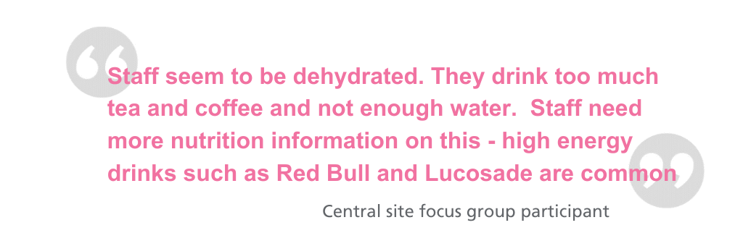
Barriers
“3 pm snack is important. But we go to cafeteria with the correct intention, but we see the muffins, which are really big so we always get one. Then we feel bad. We feel good first, but then feel bad both emotionally and physically.”
“People feel that junk food is cheap, i.e. McDonald’s and healthy is more expensive”
Notes:
Sounds simple but think back some of the barriers we’ve mentioned – limited facilities, long shift, being away from home. If we’re hoping for a healthy retirement playing with the grandkids, we need strategies to support these patterns and the workplace is a great enabler.

Slide 6
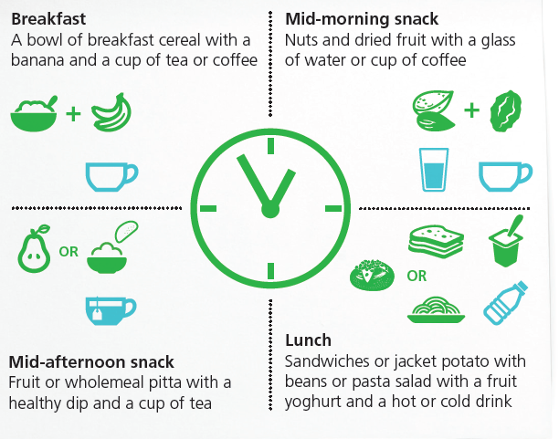
How might a working day look?
Start the
day well
Healthy snacks
Refresh & refuel
Healthy snacks
Notes:
Notes
Meal breaks are important
Snacks can be positive & nutritious :useful brain fuel & provide other nutrients
Key to healthy snacking = choices & portion sizes
Other snack ideas
Low fat yoghurt
Crackers, oat or rice cakes or veggie sticks with cottage cheese or hummus
Scones/ malt loaf /teacakes
Lower sugar/ wholegrain cereal bar
Suggested activities
Is there a food group you are not good at eating ?
Include as snacks e.g. help reach 5 a day?
Stress can mean reaching for high-fat/ high-sugar foods such as cakes, biscuits, crisps & chocolate.Do you have a danger time ? Mid morning or afternoon slumps?
Plan ahead
Keep healthy snacks in your bag , drawer or office fridge

Slide 7
Implementation in the workplace
Provision of information and support
Access to drinking water
Provide healthy food choices at work
  Vending
  Canteens
  Catering
  Availability surrounding site location
Protect your meal break
Evaluate implementation efforts to show value of workplace nutrition programmes

Slide 8

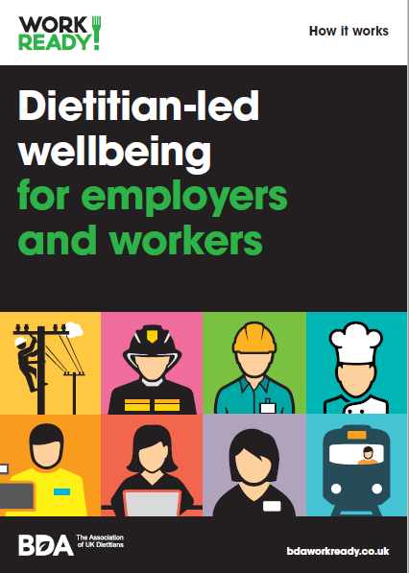
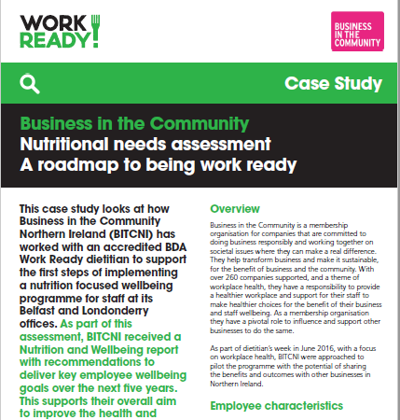
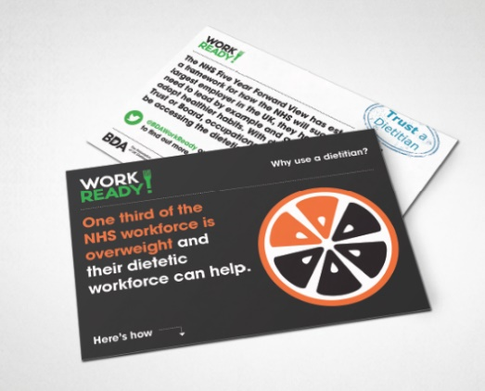
  national network of 120 accredited dietitians to design and deliver tailored interventions that support the wellbeing of your staff
  raises awareness of benefits of nutritional health in the workplace
  makes staff feel valued, while increasing knowledge of strategies to support health at work and in the future
  works as partners with existing health and wellbeing services
  www.bdaworkready.co.uk

