Slide 1


Sarah Bolton
Head of Charity Services

Slide 2






Mission
“No construction worker or their family should be alone in a crisis.”
Notes:
Read Mission: the last year has been full of unpredictability, major disruption and massive human suffering and the Lighthouse has been working tirelessly to support as many of our workforce as possible.
In 2020- 2264 we supported families, currently we have had a 40% increase year to date

Slide 3
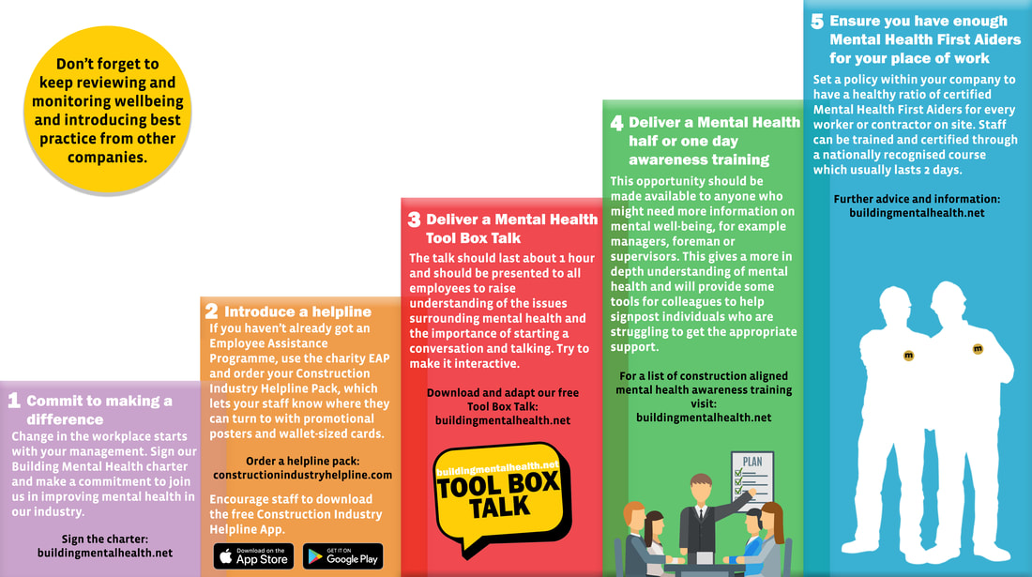

Slide 4
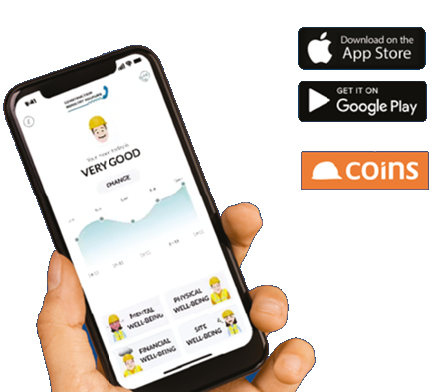
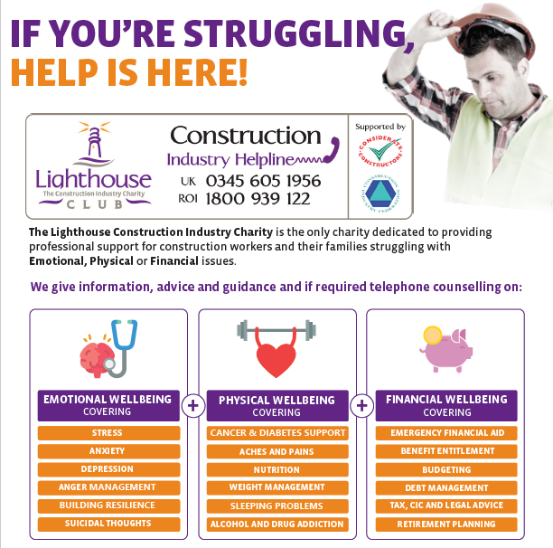

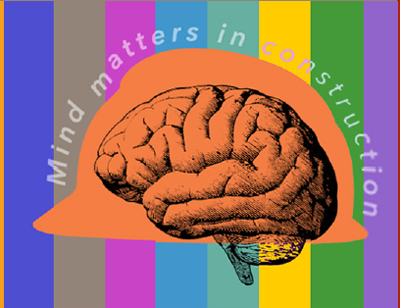
“No construction worker or their family should be
alone in a crisis”
Education
&
Training
Notes:
Our proactive offering is the app, and training so people are able to utilise the tools to help to start to manage their issue, if they require further support then they can access The basis of our support is a 24/ 7 Helpline that is always there to support anyone in our industry. It focusses support on the three key pillars of wellbeing, Emotional wellbeing, Physical Wellbeing and Financial Wellbeing. We even give non repayable Emergency Financial grants to construction families in poverty. No other Employee Assistance Programme does this. Our Helpline is backed up with a complimentary APP .
Our proactive tutored wellbeing education and training programmes, which includes 2 mental health first aid and ½ mental health awareness training are heavily subsided to the industry so we can support as many as possible proactively . Our masterclasses are CPD accredited and run monthly and are free of charge.

Slide 5
Lighthouse
Beacons of Hope
Safe spaces across the UK & Ireland that people can go to talk
Working in partnership with other men's support groups
Offer a place of safety to go and access counselling

Slide 6


3 Golden Nuggets
Ask Twice
Seek to understand before you seek to be understood
Always be kind
Notes:
Take care of others …. In the end promoting good mental health is all about being a decent human being to another human being ! THANK YOU.

Slide 7


Thank You

