Slide 1
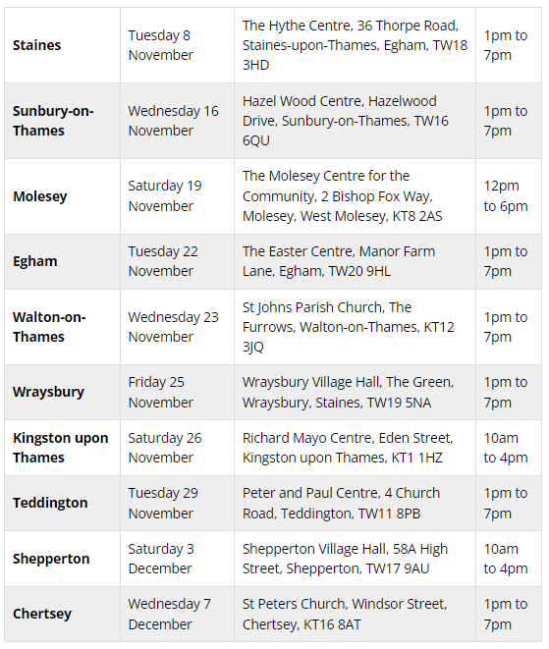
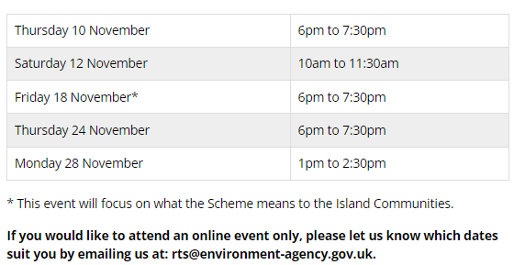
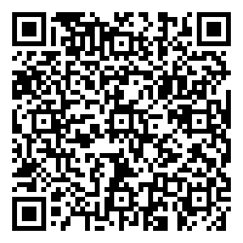
riverthamesscheme.org.uk
In Person Events
Online Webinars
Places will be limited to ensure everyone attending can ask any questions they may have. Places will be issued on a first come, first served basis.

