Slide 1

West London Construction Employers – WL Annex to London LSIP Update
March 2026

Slide 2

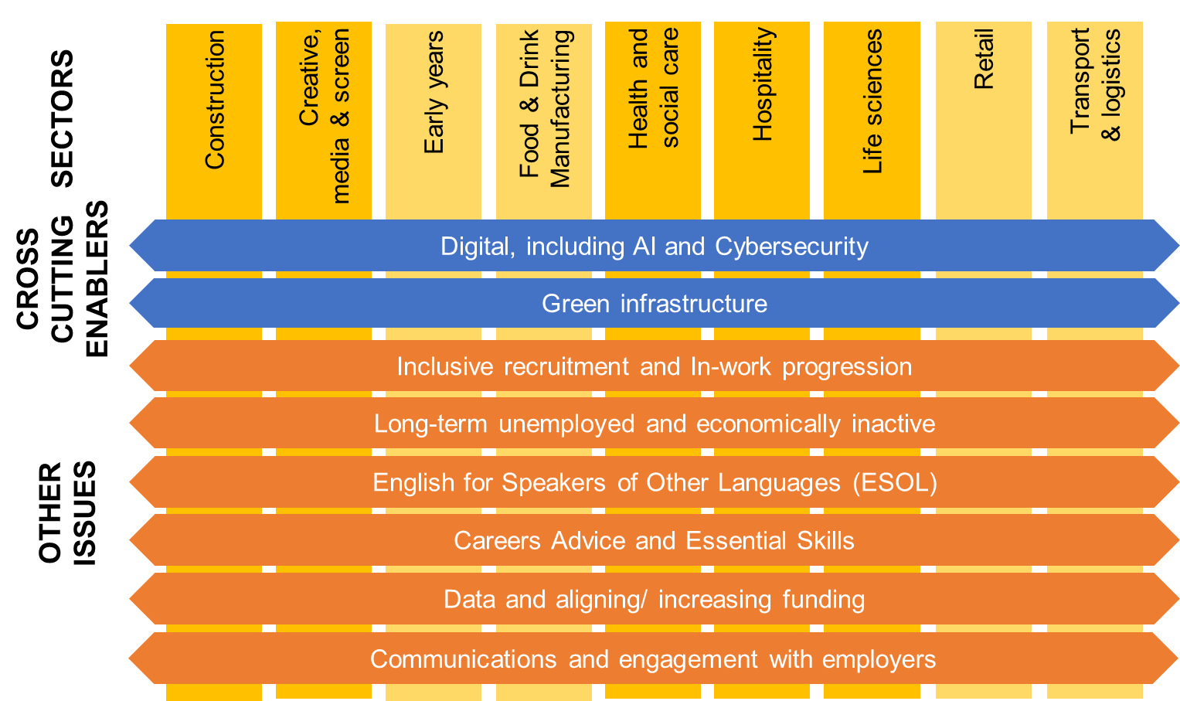
Sector focus for West London: Local Skills Improvement Plan 2
Notes:
Demand for degree level training and above, particular in STEM and related subjects, will continue to dominate some priority sectors

Slide 3
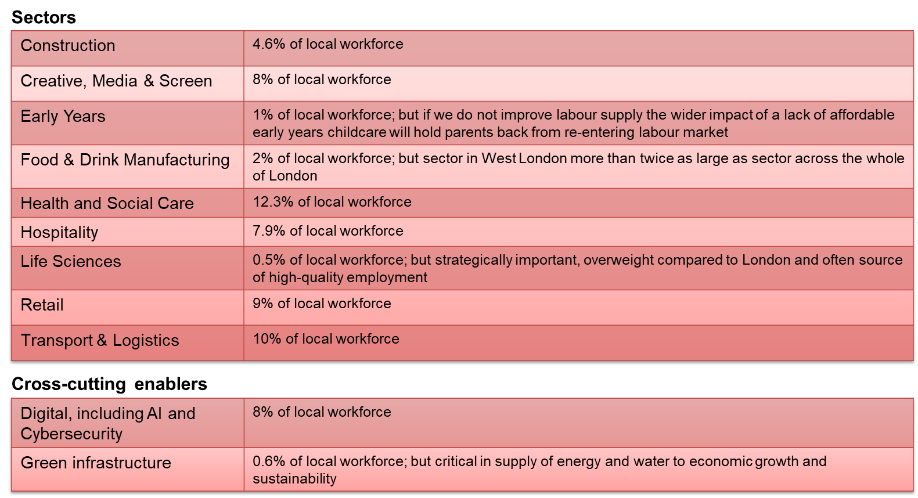
Priority sector rationale
Combined these sectors span 63.9% of West London’s workforce

Slide 4
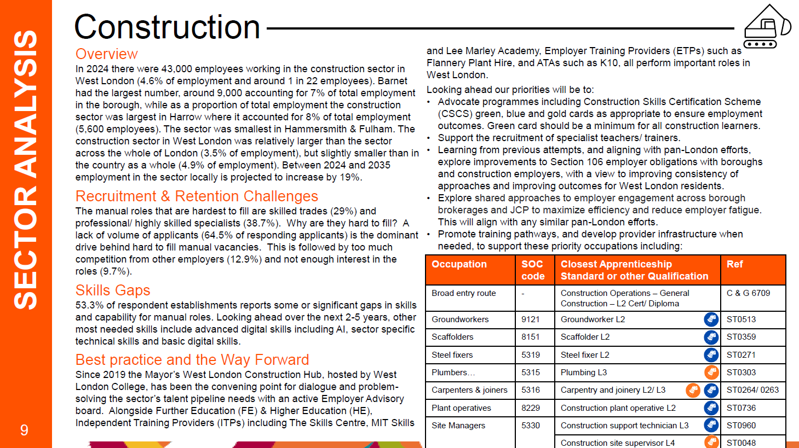

Slide 5
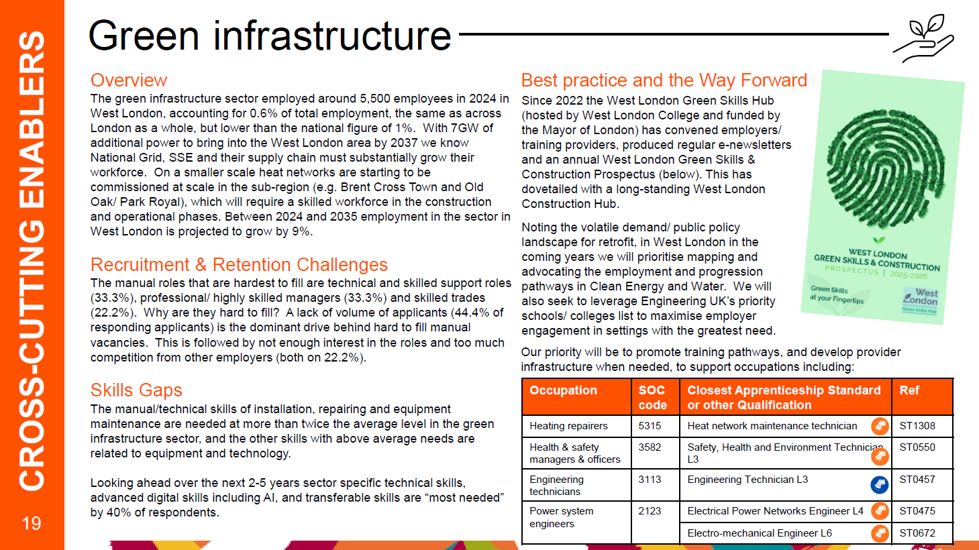

Slide 6
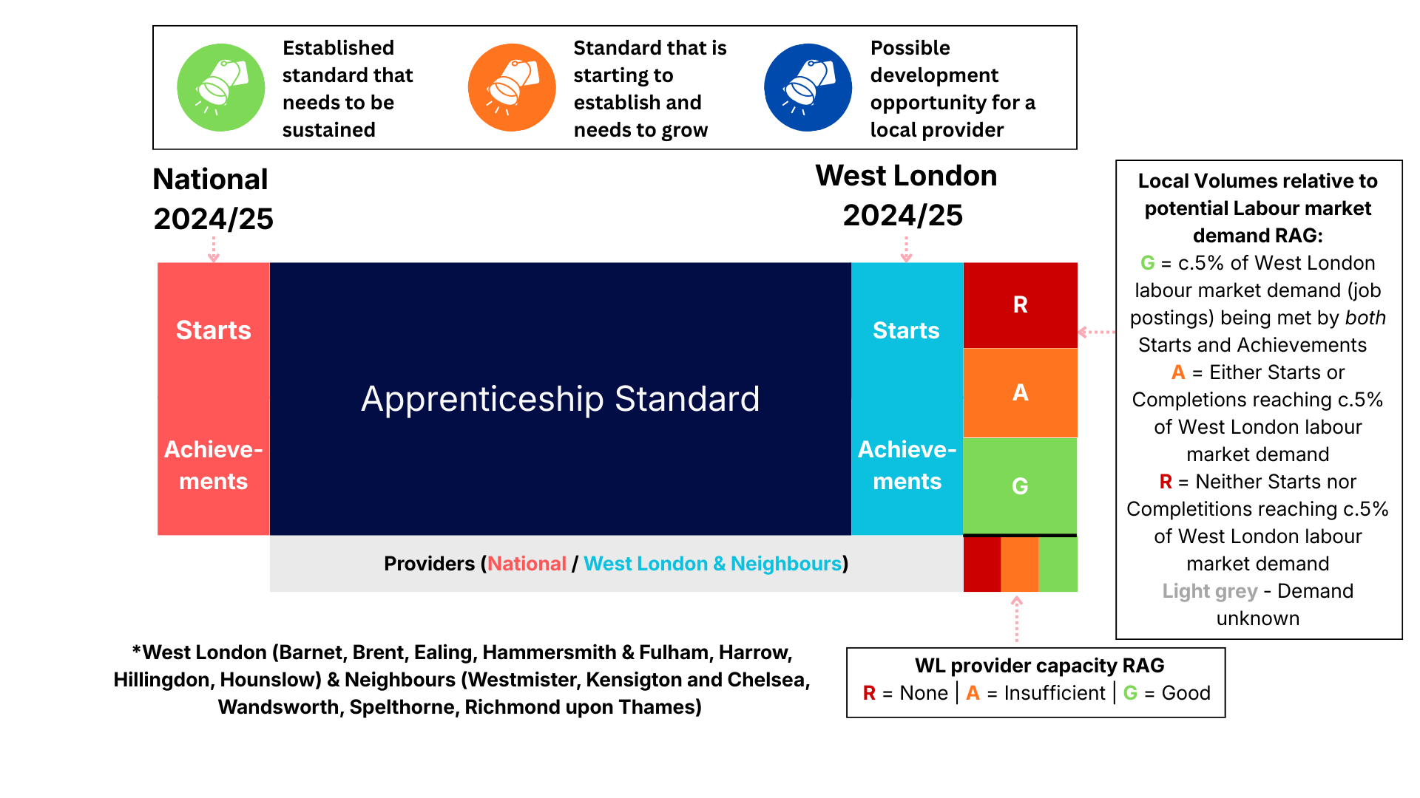

Slide 7
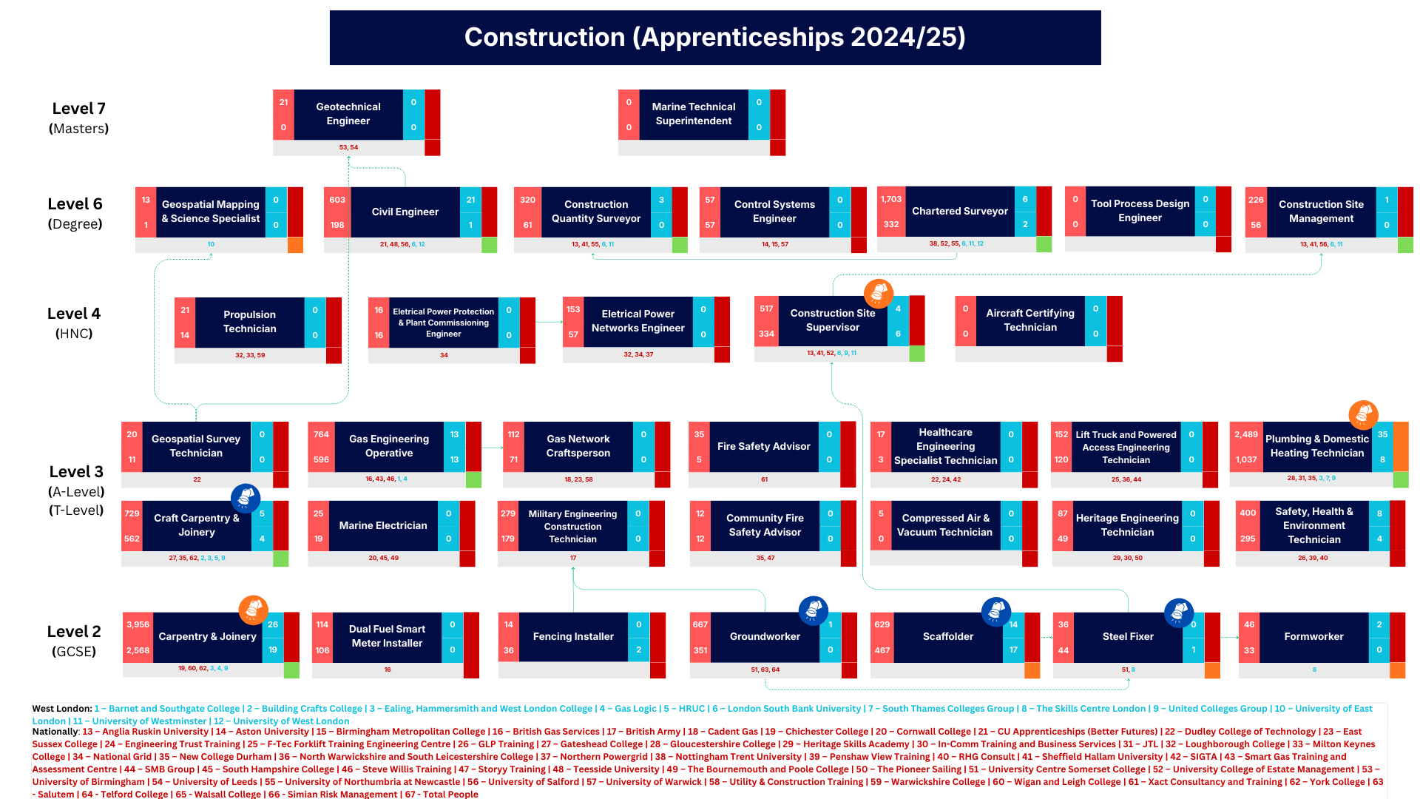

Slide 8
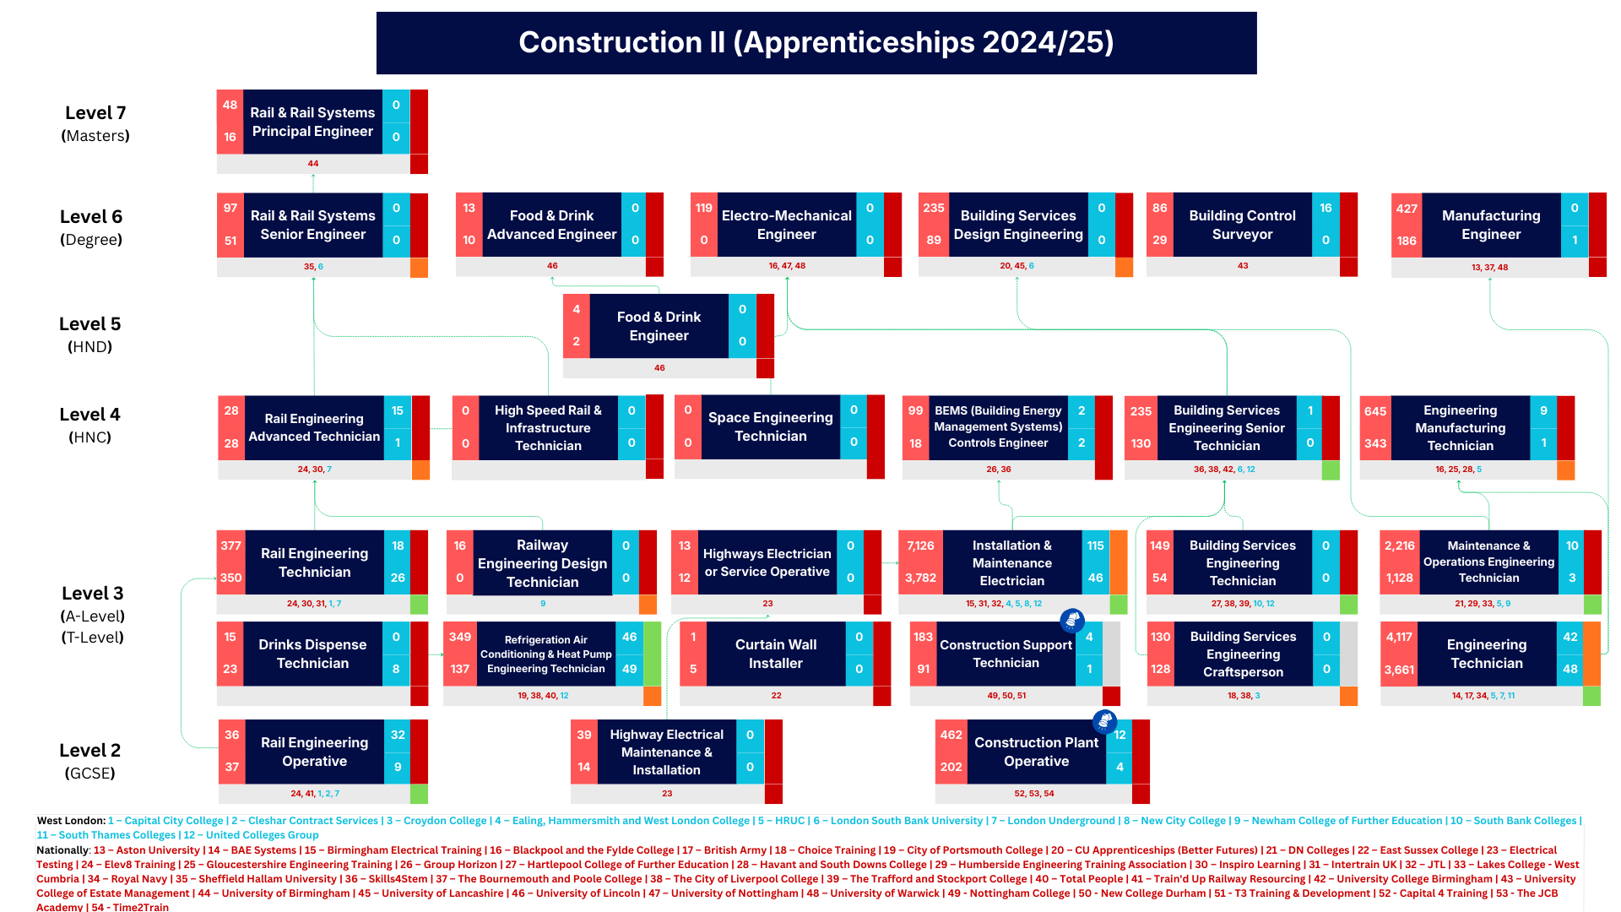

Slide 9
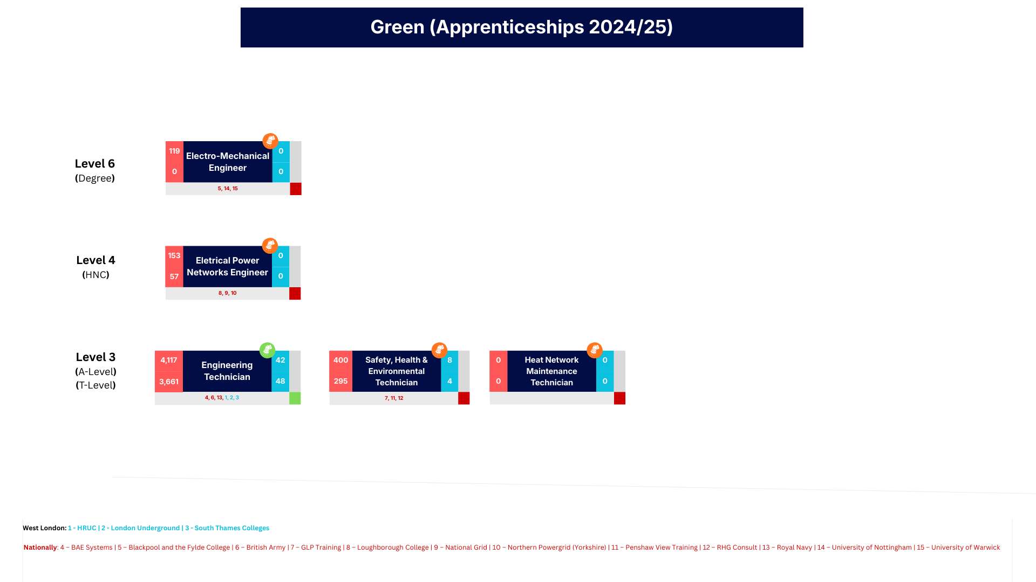

Slide 10
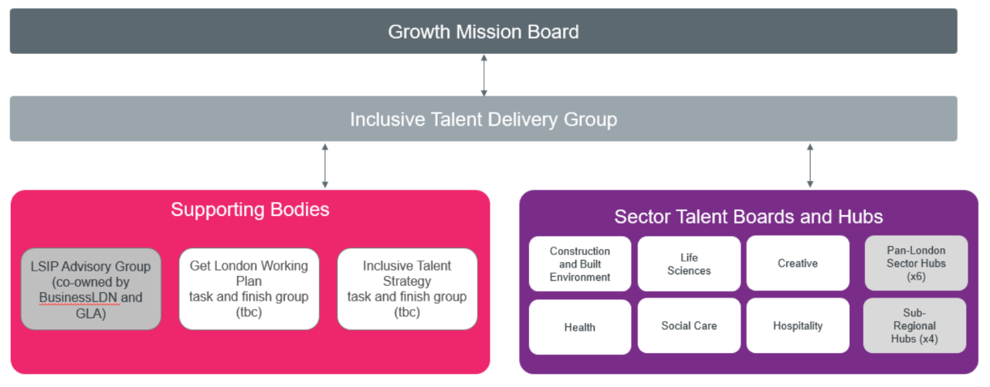
Mayor’s Inclusive Talent Strategy (ITS) and future Skills Boards/ Hubs
Continued shift to employer-led system learning from Skillnet Ireland: https://www.skillnetireland.ie/sectors
Information/ insight flow between boards and levels critical to success
WL Stakeholder analysis against boards needed (e.g. Flannery & Thames Water on construction board)

Slide 11





Mayor’s Inclusive Talent Strategy (ITS) and future of Skills Boards/ Hubs Cont…
West London Skills & Employment Board
West London Skills Hub
Advanced digital skills, AI and data centres
Green infrastructure (clean energy)
Hospitality
Screen industries and creative tech
+ Transport
Life Sciences Innovation & Skills Hub

Slide 12
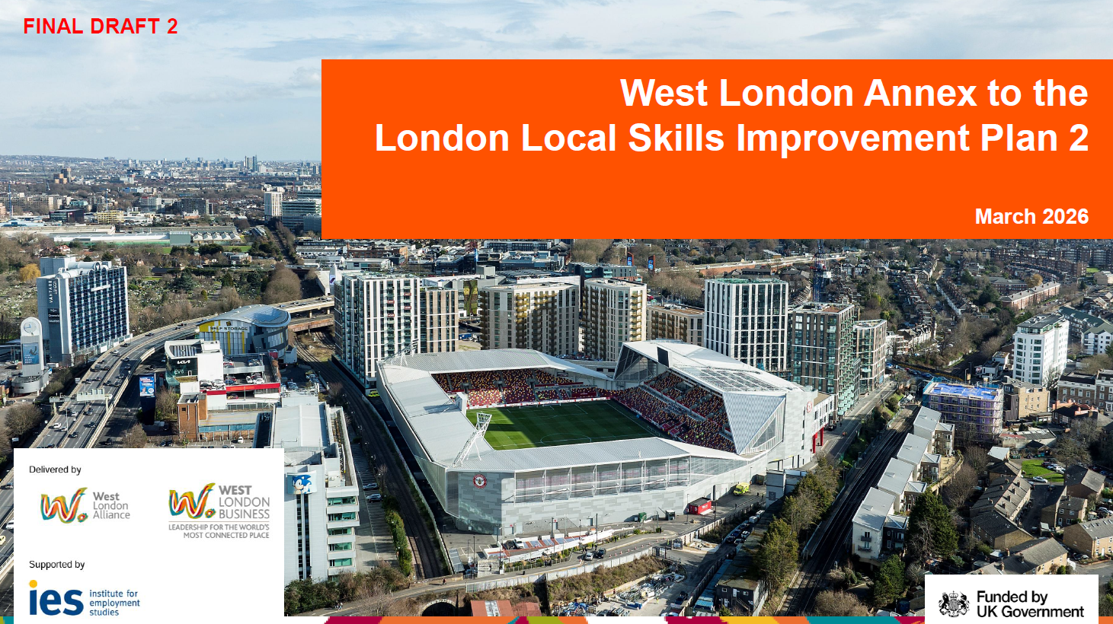
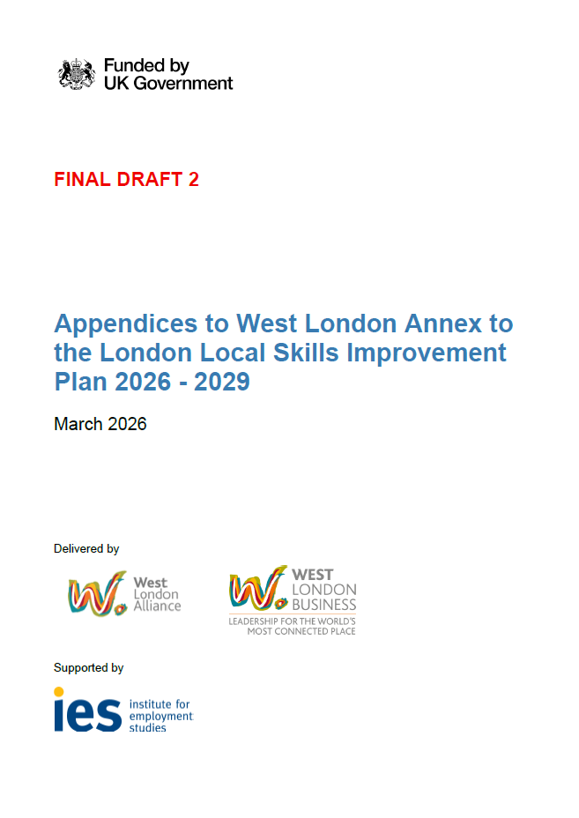
Next steps
LSIP with GLA and then SoS for DfE for approval
West London Skills Hubs proposal with GLA for review
  £300k/ annum for three years managed by WLA, supported by WLB
Download >>
Download >>

